Slide 1
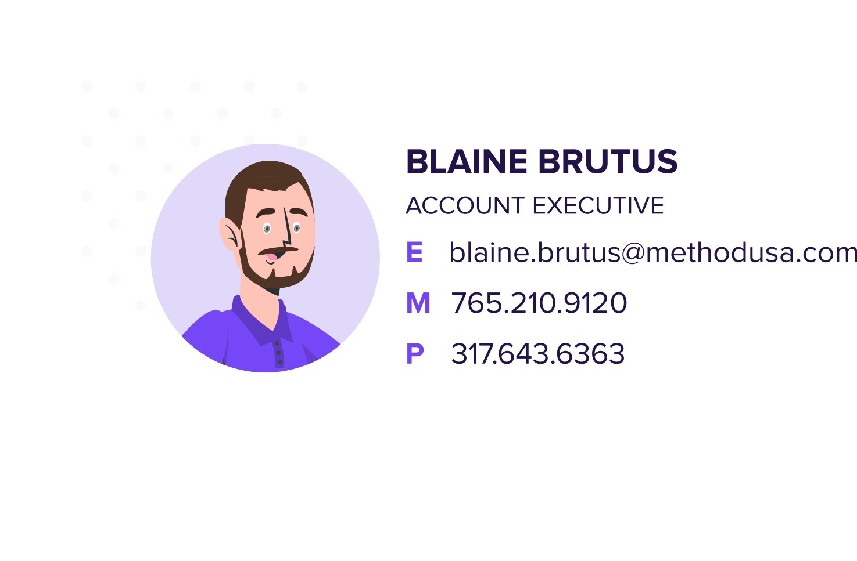
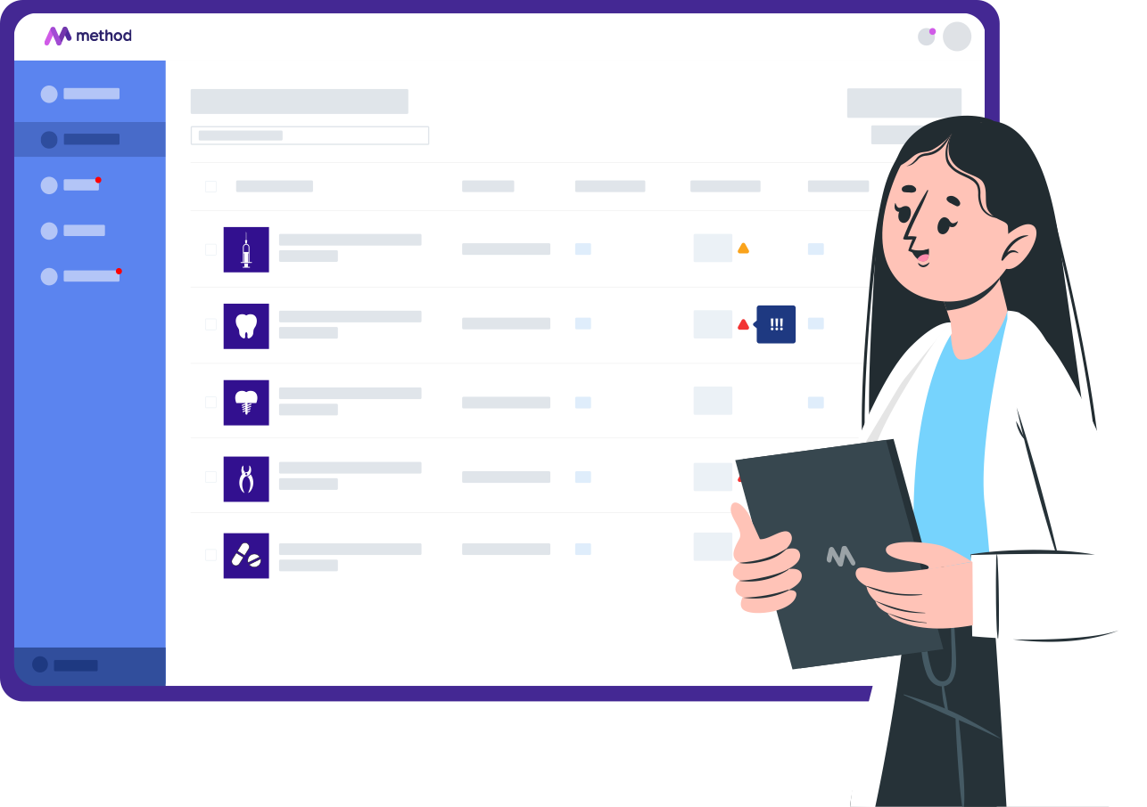

Slide 2
More Partners, More Savings, More Value
Dental savings on supplies through membership association.
Exclusive promotions and pricing.
Discounted lab products with savings up to 60%.
Implant solutions.
Insurance reimbursement and marketing services.
Market-leading e-procurement technology

Slide 3
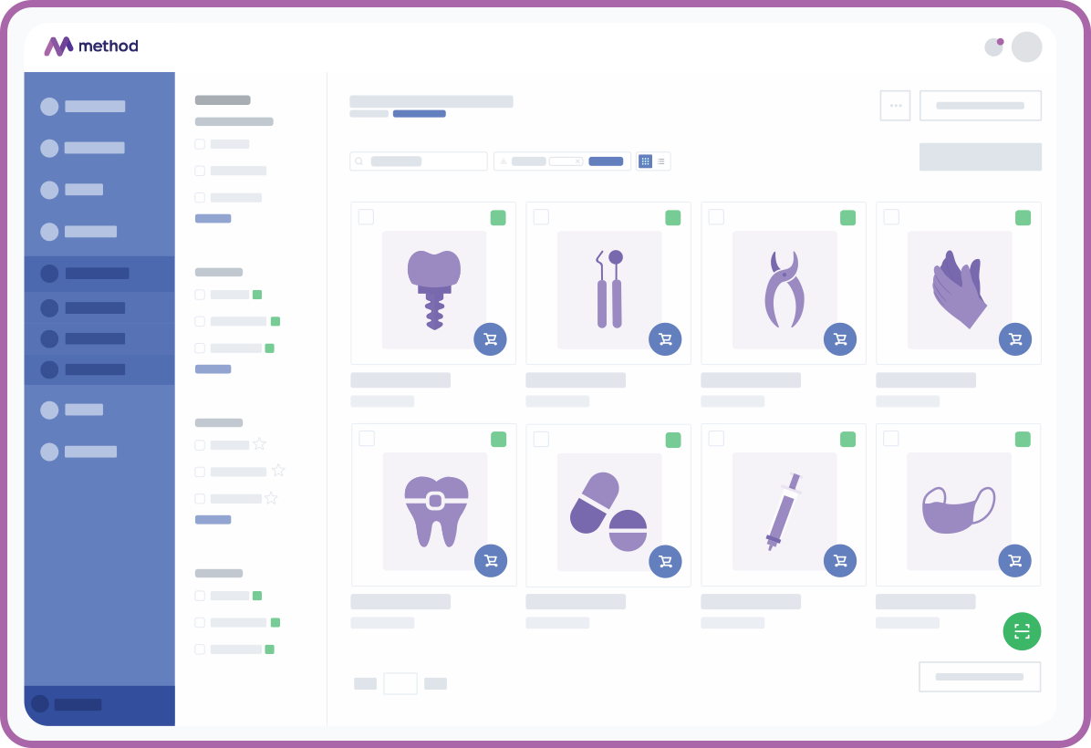
E-PROCUREMENT
ONE-STOP
75
SUPPLIERS
600,000
4,000+
PRODUCTS
MEMBERS

Slide 4
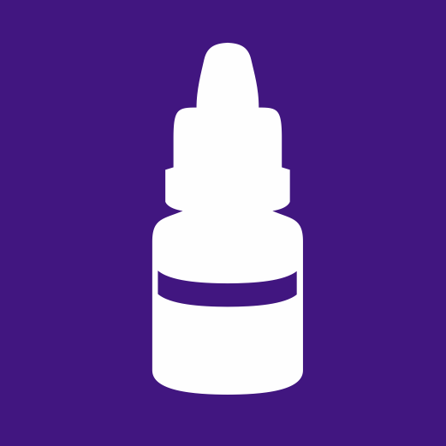
Injectable Anesthetic
SEPTOCAINE 4% 1:100 GOLD 01A1400
050PK
Glass Ionomers
FUJI II LC CAPSULE A2 425002
048BX
43%
31%
INDUSTRY
$58.29
SYNERGY
$51.95 (11%)
METHOD
$33.18 (36%)
COMBINED
SAVINGS
INDUSTRY
$317.82
SYNERGY
$261.07 (18%)
METHOD
$217.56 (17%)
COMBINED
SAVINGS
Gloves
GLOVES AURELIA AMAZING PF N SM92886 300BX
Cements
iBond Bonding Agent Bottle Assortment
EACH
29%
43%
INDUSTRY
$36.94
SYNERGY
$37.90 (0%)
METHOD
$27.00 (29%)
COMBINED
SAVINGS
INDUSTRY
$188.40
SYNERGY
$156.61 (17%)
METHOD
$107.20 (32%)
COMBINED
SAVINGS
DARBY DISCOUNTS WITH SYNERGY & METHOD

Slide 5
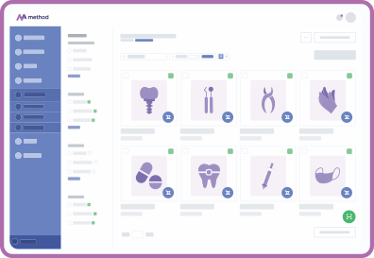
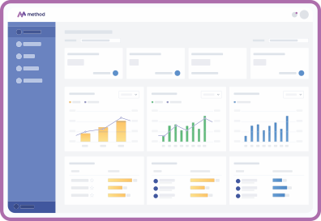
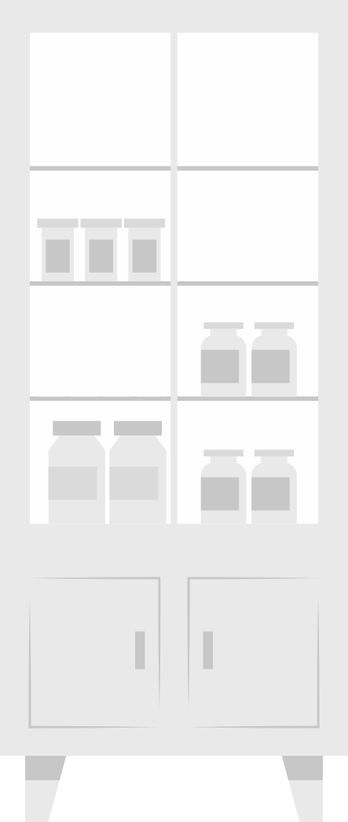
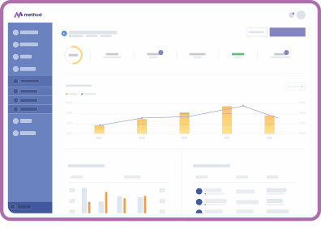
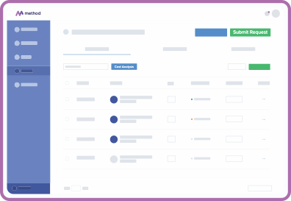
The EASIEST Method for ordering dental supplies for your practice.
DISCOUNTED PURCHASING
One easy-to-use platform that’s manages all your supply purchasing ensuring you always get the best possible price.
COST AVOIDANCE
Effortlessly improve inventory management and reduce waste by eliminating costs that do not add value.
FINANCIAL OVERSIGHT
Tighten your payables process and control spending by using budgeting and pre-purchase ordering review.
ALIGN OPERATIONS
Establish custom formularies and catalogs along with role-based rules and permissions at the office and user level.

Slide 6
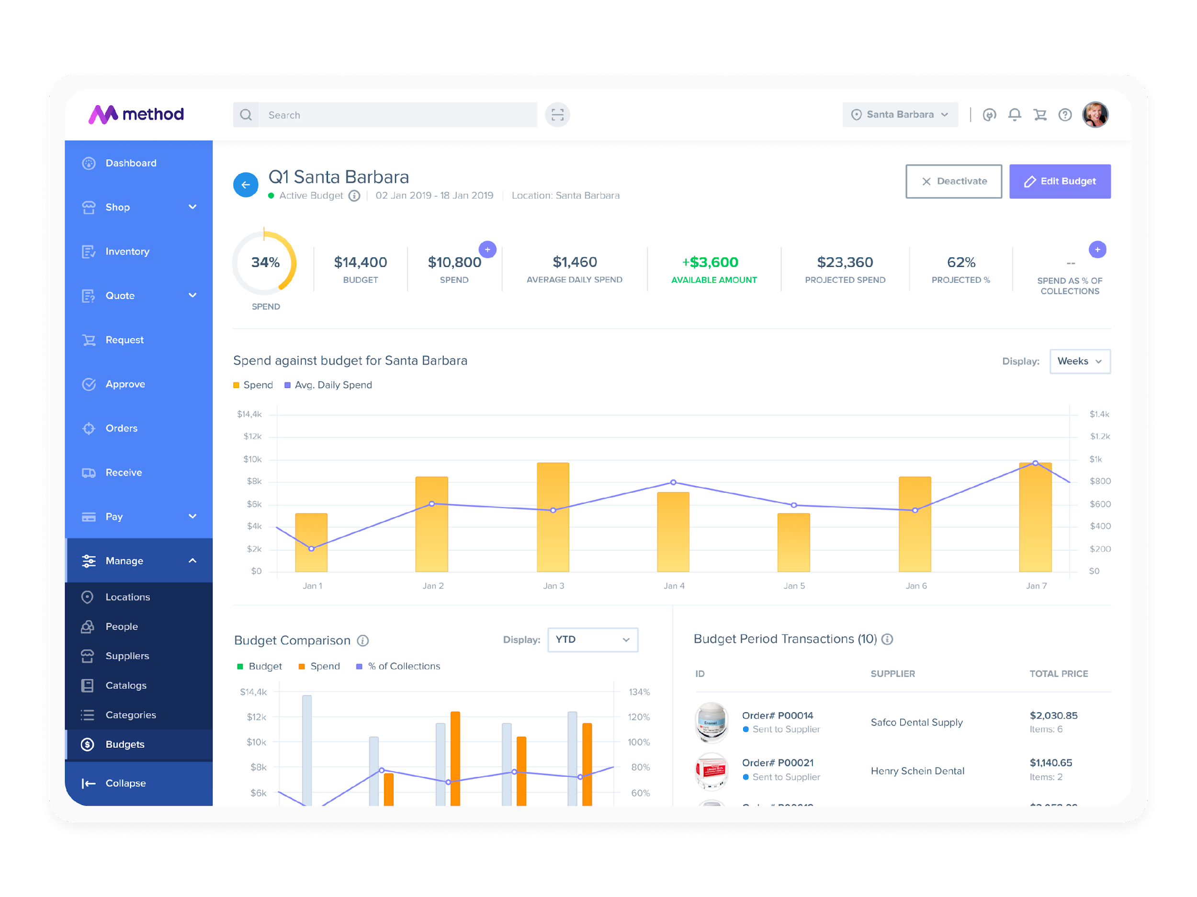
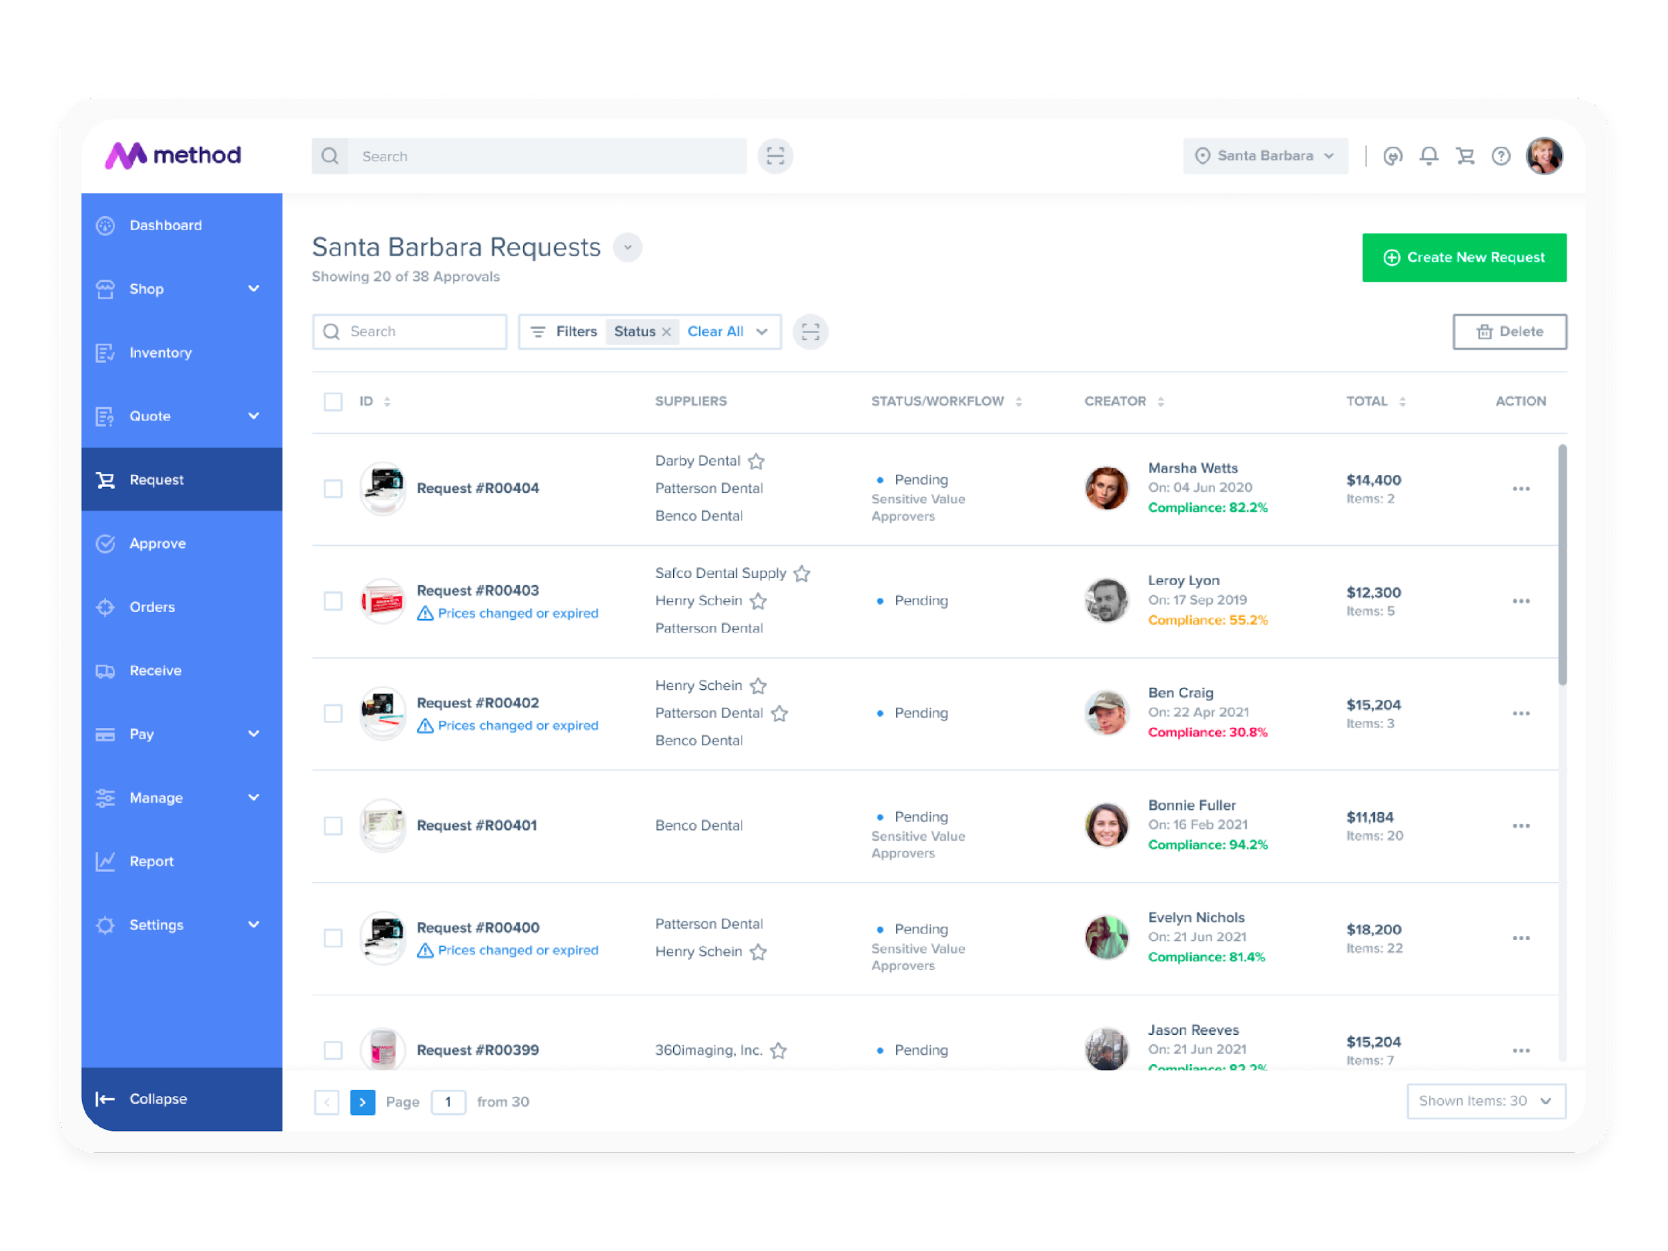
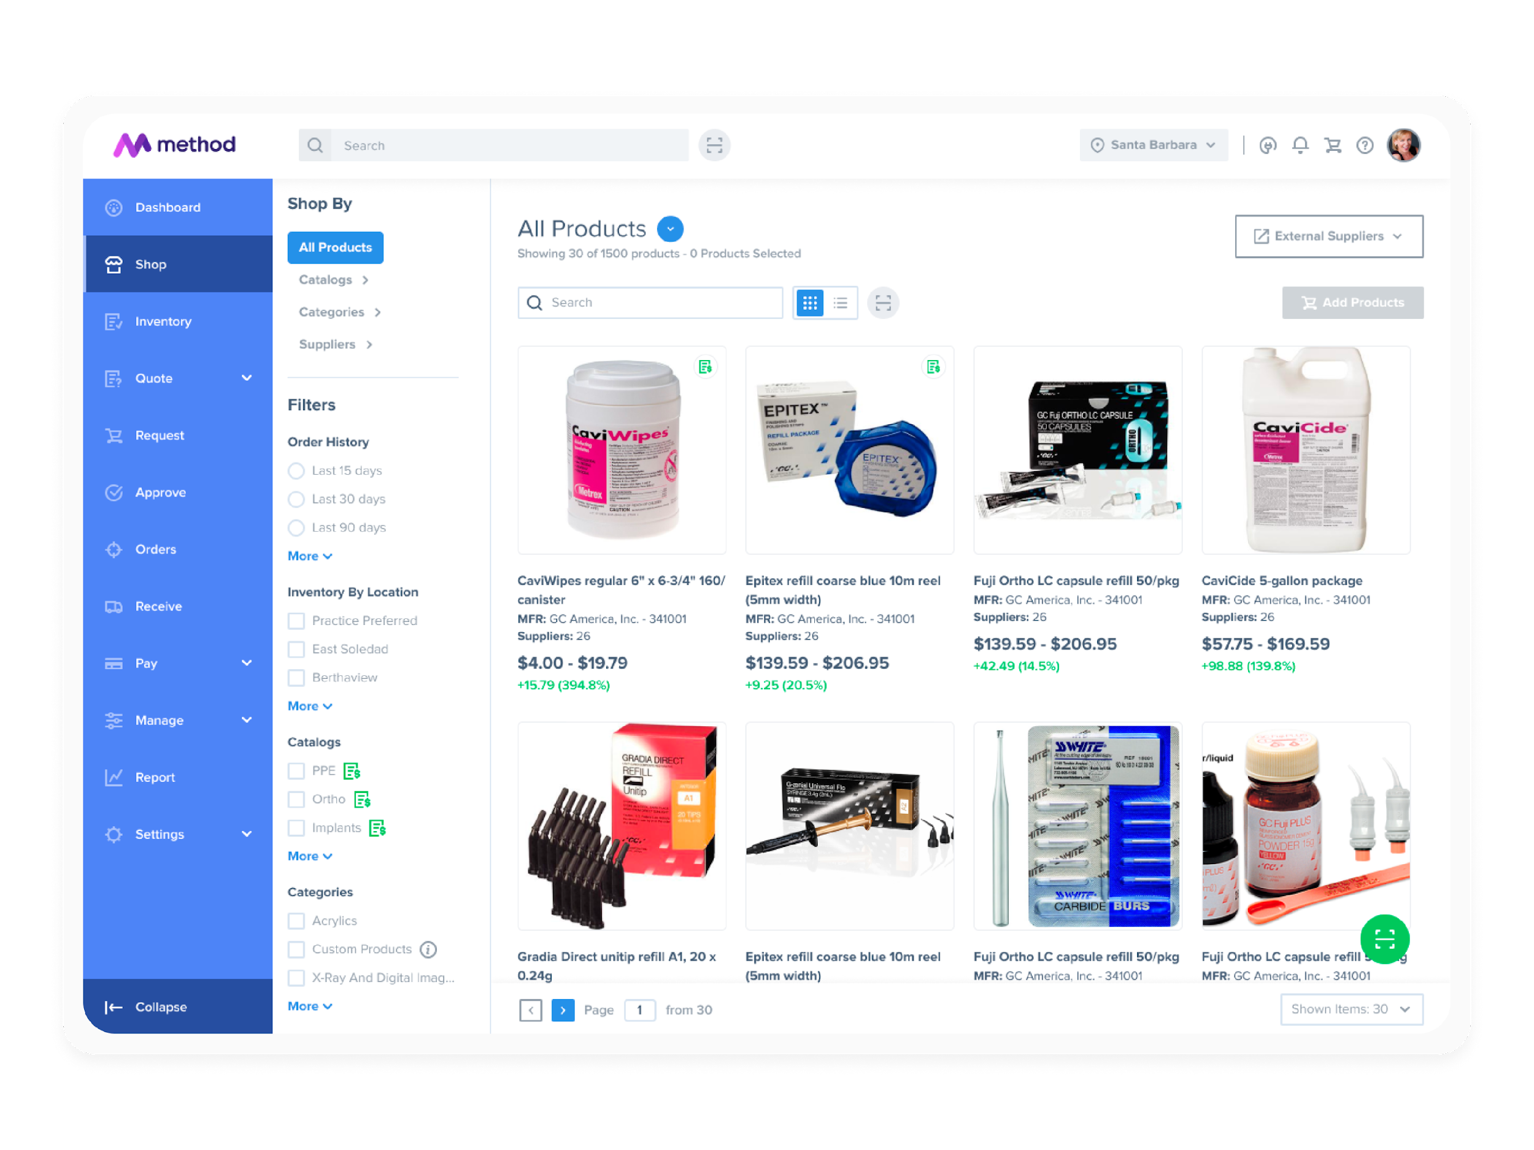
How Dental Practices BENEFIT from WORKING with METHOD.
Can now control costs and drive improvement in bottom line results.
Method frees up time by automating repetitive supply ordering tasks.
Values the costs savings and staffing efficiencies that Method delivers.
DOCTOR
OWNER
PRACTICE
DENTAL ASSISTANTS
OFFICE
MANAGER

